Slide 1
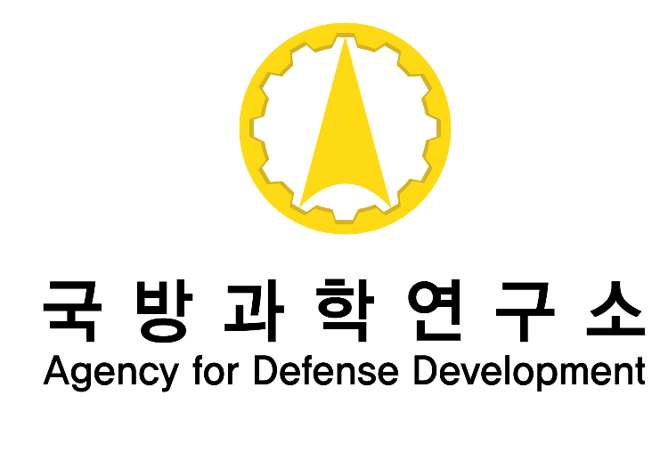
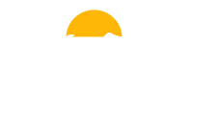
Multi-Agent Network Randomization for Robust Knowledge Transfer in Deep Multi-Agent Reinforcement Learning
Dohyun Kim, Hoseong Jung, Jungho Bae*
Agency for Defense Development
00dh.kim@gmail.com
Notes:
I’m Dohyun Kim, and today I introduce our study, ~~

Slide 2

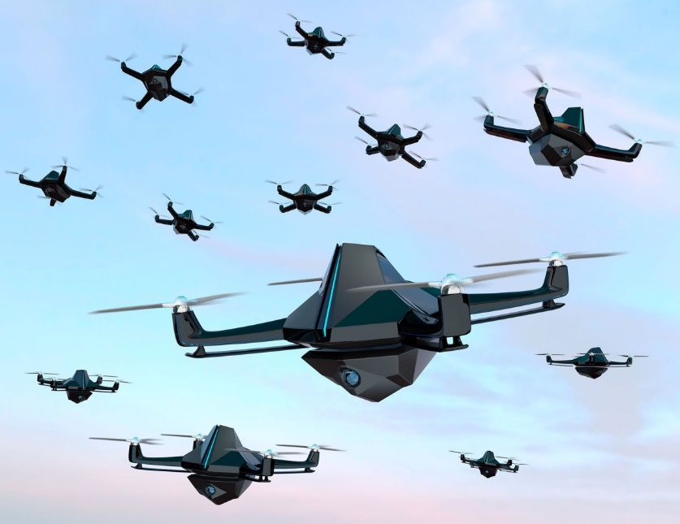
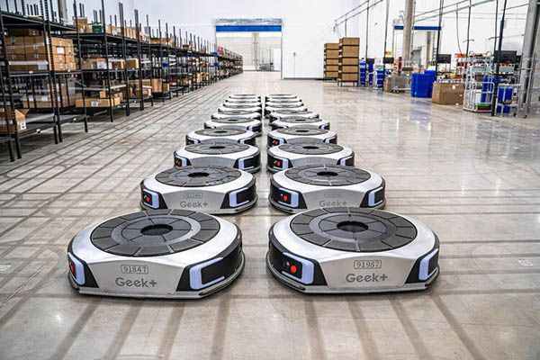
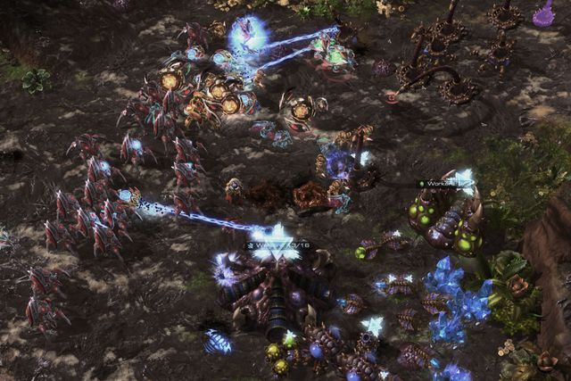
Multi-Agent Reinforcement Learning
swarm drone control
logistics robot collaboration
multi-agent game AI
Cooperative multi-agent reinforcement learning(MARL) is a framework for multiple agents to learn policies towards a common goal. [1]
Problem in MARL: large state and action space
Conventional solution: reward shaping(e.g., SMMAE), CTDE paradigm(e.g., QMIX), and so on.
[1] K. Zhang, Z. Yang, and T. Başar, "Multi-agent reinforcement learning: A selective overview of theories and algorithms," Handbook of Reinforcement Learning and Control, pp. 321–384, 2021.
Notes:
Multi-agent systems require control over each agent to achieve a common goal, and they have high scalability for various applications, such as ~~
In particular, ~~
MARL suffers from a large state and action space compared to single-agent RL, which makes the learning process more difficult.
Several approaches have been proposed to solve this problem, such as reward shaping, CTDE paradigm, which means centralized training with decentralized execution.
However, we aimed to solve the problem by improving sample efficiency.

Slide 3
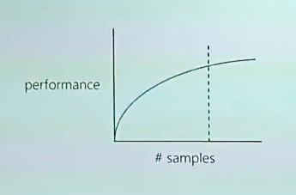
Sample Efficiency in Multi-Agent RL
agent
agent
agent
agent
environment
agent-env. interaction
agent-agent interaction
sample efficiency with a limited budget [2]
Multi-agent setting framework
Sample efficiency: how well a model can perform with limited training data
In multi-agent settings, the state and action space grow exponentially with the number of agents.
[2] H. Van Seijen, "Sample Efficient RL," presented at the DLRL Summer School, Edmonton, AB, Canada, Jul. 24 - Aug. 2, 2019. [Online]. Available: https://www.youtube.com/watch?v=DT2MbIeec4U
Notes:
Sample efficiency means how well a model can perform with limited training data.
It’s important because collecting training data is time-consuming and uses a lot of computing resources.
Specifically, in multi-agent settings, agents interact not only with the environment but also with other agents.
It leads to larger state and action spaces with the number of agents.
To solve this challenge, we explore sample efficient learning to train good policies with limited interactions.

Slide 4
Transfer Learning
source environment
agent(s)
knowledge transfer
agent(s)
target environment
※ task, scenario, and environment are all same terms in this announcement.
Transfer learning refers to an approach that knowledge gathered in a source task is utilized in a target task. [3]
In particular, learning a new environment from scratch requires a large number of samples.
[3] Z. Zhu, Y. Zhang, S. Li, and X. Wang, "Transfer learning in deep reinforcement learning: A survey," IEEE Transactions on Pattern Analysis and Machine Intelligence, 2023.
Notes:
We concentrated on transfer learning to deal with sample efficiency.
It is regarded as one of the most popular methods for improving sample efficiency in reinforcement learning.
(2) ~~
(3) ~~
(4) Transfer learning can reduce this problem by applying learned knowledge to target task.
(5) This approach in turn helps to improve the sample efficiency of RL.

Slide 5
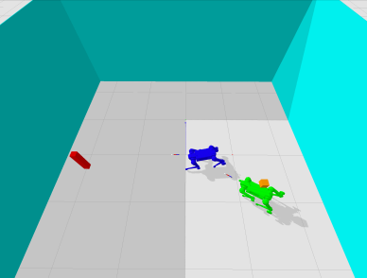
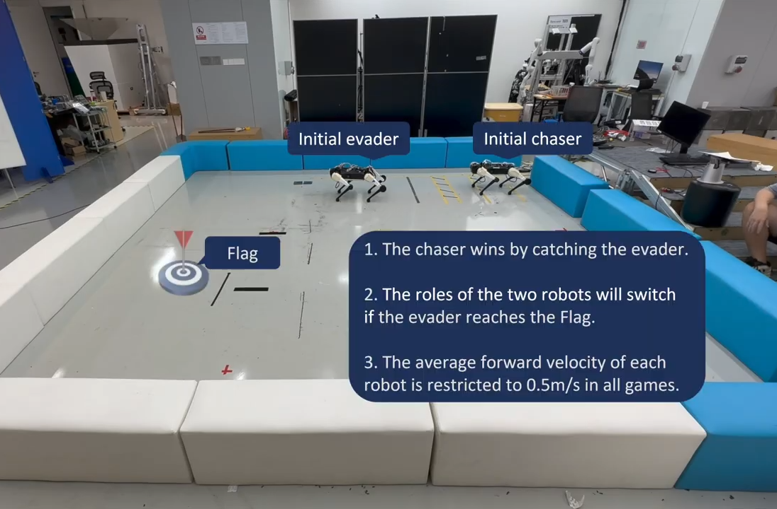
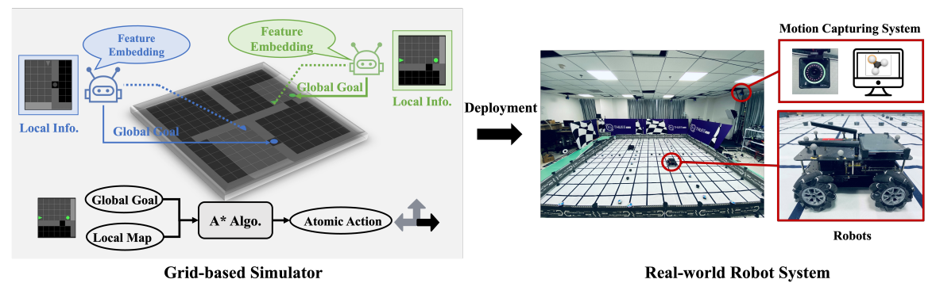
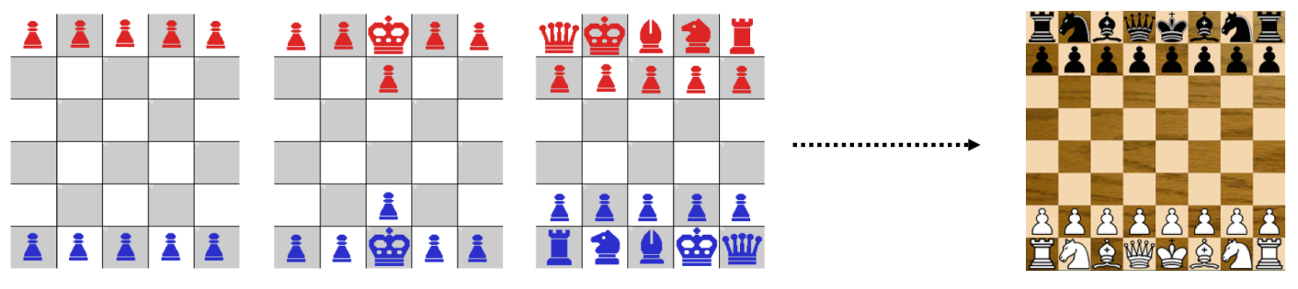
Transfer Learning Examples
simplified chess board and original chess game [4]
sim-to-real transfer for multi-robot exploration problem [5]
[4] S. Narvekar, B. Peng, M. Leonetti, J. Sinapov, M. E. Taylor, and P. Stone, "Curriculum learning for reinforcement learning domains: A framework and survey," Journal of Machine Learning Research, vol. 21, no. 181, pp. 1–50, 2020.
[5] C. Yu, X. Yang, J. Gao, J. Chen, Y. Li, J. Liu, Y. Xiang, R. Huang, H. Yang, and Y. Wu, "Asynchronous multi-agent reinforcement learning for efficient real-time multi-robot cooperative exploration," in Proceedings of the 2023 International Conference on Autonomous Agents and Multiagent Systems, 2023, pp. 1107-1115.
Notes:
(1) There are several examples of using transfer learning to increase sample efficiency.
(2) First of all, starting with a simplified chess board and advancing to the original chess game, the agent can make rapid progress.
(3) Next, since real-world interaction is expensive, transferring agents trained in simulation to the real world can reduce learning costs.

Slide 6
Motivation
source – target
gap
source environment
agent(s)
knowledge transfer
agent(s)
target environment
Conventional Transfer Learning
source environment
agent(s)
knowledge transfer
agent(s)
target environment
reduced gap
Our Transfer Learning
Our method
There is a gap between the source task and the target task.
Our method collecting task-invariant knowledge
Notes:
Transfer learning has many benefits, but there is a gap between the source task and the target task.
This gap hinders the performance of transfer learning.
It should be addressed during source task learning.
However, many transfer learning methods do not consider extension to the target task.
To improve this, we propose a method for collecting task-invariant knowledge through exploration in the source task.

Slide 7
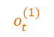
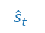
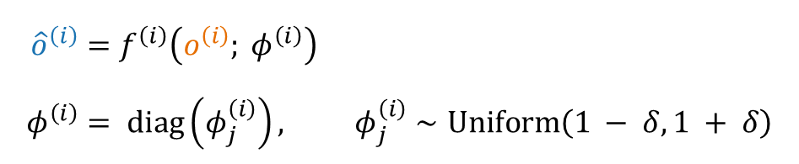
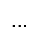
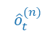
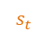
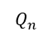
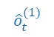
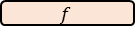
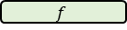
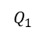
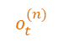
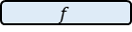
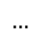
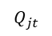
Method
Our proposed multi-agent network randomization(MANR) method is implemented by adding a random layer to the MARL framework.
$$Q_{jt}$$
Mixer
$${\hat{o}}^{\left(i\right)}=f^{\left(i\right)}\left(o^{\left(i\right)}; φ^{\left(i\right)}\right) \\ φ^{\left(i\right)}= diag\left(φ_{j}^{\left(i\right)}\right), φ_{j}^{\left(i\right)}∼Uniform\left(1 − δ, 1 + δ\right)$$
$$Q_{1}$$
$$Q_{n}$$
agent 1
$$…$$
agent N
$${\hat{s}}_{t}$$
$${\hat{o}}_{t}^{(1)}$$
$${\hat{o}}_{t}^{(n)}$$
$$f$$
$$f$$
$$f$$
$$o_{t}^{(1)}$$
$$…$$
$$s_{t}$$
$$o_{t}^{(n)}$$
Advantages:
Increase the diversity of the data --> generalized and robust knowledge
Reduce overfitting to specific observation patterns
The MANR framework
Notes:
(1) ~~
(2) Each agents’ observations are randomized by a random layer, which is parameterized by phi.
Each element phi_j is independently sampled from a uniform distribution.
(3) It aims to increase the diversity of the data so that the agents learn generalized and robust policies.
There are two advantages.
(4) First of all, the diversity helps the agents learn generalized knowledge, and allows for robust transfer to target task.
(5) Second, the injected randomness decreases overfitting to specific observation patterns.

Slide 8
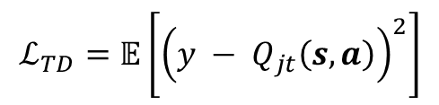
Method
QMIX [6]: individual agent networks + mixer network
individual agent networks
input: observation, output: Q-values
mixer network
combines Q-values to predict team rewards
$$Q_{jt}$$
Mixer
$$Q_{1}$$
$$Q_{n}$$
agent 1
$$…$$
agent N
$${\hat{s}}_{t}$$
$${\hat{o}}_{t}^{(1)}$$
$${\hat{o}}_{t}^{(n)}$$
$$f$$
$$f$$
$$f$$
$$o_{t}^{(1)}$$
$$…$$
$$s_{t}$$
$$o_{t}^{(n)}$$
The MANR framework
$$ℒ_{TD}=𝔼\left.\left[{\left(y − Q_{jt}\left(s, a\right)\right)}^{2}\right.\right]$$
[6] T. Rashid, M. Samvelyan, C. S. De Witt, G. Farquhar, J. Foerster, and S. Whiteson, "Monotonic value function factorisation for deep multi-agent reinforcement learning," Journal of Machine Learning Research, vol. 21, no. 178, pp. 1–51, 2020.
Notes:
Our method can be applied to most MARL algorithms, and we applied it to the QMIX algorithm. QMIX is popular and fundamental algorithm in MARL.
QMIX consists of individual agent networks and a mixer network.
The agent networks take observations as input and generate Q-values representing the expected reward for each action.
The mixer network combines these Q-values to predict team rewards, which enables cooperative decision making during backpropagation by assigning rewards to each agent.
The framework is trained using TD loss, defined as the mean squared error between the target Q-value based on actual rewards and the model's predicted Q-value.

Slide 9
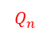
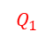
Method
QMIX [6]: individual agent networks + mixer network
individual agent networks
input: observation, output: Q-values
mixer network
combines Q-values to predict team rewards
$$Q_{jt}$$
Mixer
$$Q_{1}$$
$$Q_{n}$$
agent 1
$$…$$
agent N
$${\hat{s}}_{t}$$
$${\hat{o}}_{t}^{(1)}$$
$${\hat{o}}_{t}^{(n)}$$
$$f$$
$$f$$
$$f$$
$$o_{t}^{(1)}$$
$$…$$
$$s_{t}$$
$$o_{t}^{(n)}$$
The MANR framework
$$ℒ_{TD}=𝔼\left.\left[{\left(y − Q_{jt}\left(s, a\right)\right)}^{2}\right.\right]$$
[6] T. Rashid, M. Samvelyan, C. S. De Witt, G. Farquhar, J. Foerster, and S. Whiteson, "Monotonic value function factorisation for deep multi-agent reinforcement learning," Journal of Machine Learning Research, vol. 21, no. 178, pp. 1–51, 2020.
Notes:
Our method can be applied to most MARL algorithms, and we applied it to the QMIX algorithm. QMIX is popular and fundamental algorithm in MARL.
QMIX consists of individual agent networks and a mixer network.
The agent networks take observations as input and generate Q-values representing the expected reward for each action.
The mixer network combines these Q-values to predict team rewards, which enables cooperative decision making during backpropagation by assigning rewards to each agent.
The framework is trained using TD loss, defined as the mean squared error between the target Q-value based on actual rewards and the model's predicted Q-value.

Slide 10
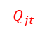
Method
QMIX [6]: individual agent networks + mixer network
individual agent networks
input: observation, output: Q-values
mixer network
combines Q-values to predict team rewards
$$Q_{jt}$$
Mixer
$$Q_{1}$$
$$Q_{n}$$
agent 1
$$…$$
agent N
$${\hat{s}}_{t}$$
$${\hat{o}}_{t}^{(1)}$$
$${\hat{o}}_{t}^{(n)}$$
$$f$$
$$f$$
$$f$$
$$o_{t}^{(1)}$$
$$…$$
$$s_{t}$$
$$o_{t}^{(n)}$$
The MANR framework
$$ℒ_{TD}=𝔼\left.\left[{\left(y − Q_{jt}\left(s, a\right)\right)}^{2}\right.\right]$$
[6] T. Rashid, M. Samvelyan, C. S. De Witt, G. Farquhar, J. Foerster, and S. Whiteson, "Monotonic value function factorisation for deep multi-agent reinforcement learning," Journal of Machine Learning Research, vol. 21, no. 178, pp. 1–51, 2020.
Notes:
Our method can be applied to most MARL algorithms, and we applied it to the QMIX algorithm. QMIX is popular and fundamental algorithm in MARL.
QMIX consists of individual agent networks and a mixer network.
The agent networks take observations as input and generate Q-values representing the expected reward for each action.
The mixer network combines these Q-values to predict team rewards, which enables cooperative decision making during backpropagation by assigning rewards to each agent.
The framework is trained using TD loss, defined as the mean squared error between the target Q-value based on actual rewards and the model's predicted Q-value.

Slide 11
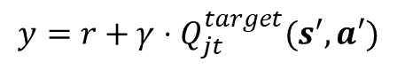
Method
QMIX [6]: individual agent networks + mixer network
individual agent networks
input: observation, output: Q-values
mixer network
combines Q-values to predict team rewards
$$Q_{jt}$$
Mixer
$$Q_{1}$$
$$Q_{n}$$
agent 1
$$…$$
agent N
$${\hat{s}}_{t}$$
$${\hat{o}}_{t}^{(1)}$$
$${\hat{o}}_{t}^{(n)}$$
$$f$$
$$f$$
$$f$$
$$o_{t}^{(1)}$$
$$…$$
$$s_{t}$$
$$o_{t}^{(n)}$$
The MANR framework
$$ℒ_{TD}=𝔼\left.\left[{\left(y − Q_{jt}\left(s, a\right)\right)}^{2}\right.\right]$$
model’s predicted Q-value
target Q-value
$$y=r+γ⋅Q_{jt}^{target}(s^{′},a′)$$
[6] T. Rashid, M. Samvelyan, C. S. De Witt, G. Farquhar, J. Foerster, and S. Whiteson, "Monotonic value function factorisation for deep multi-agent reinforcement learning," Journal of Machine Learning Research, vol. 21, no. 178, pp. 1–51, 2020.
Notes:
Our method can be applied to most MARL algorithms, and we applied it to the QMIX algorithm. QMIX is popular and fundamental algorithm in MARL.
QMIX consists of individual agent networks and a mixer network.
The agent networks take observations as input and generate Q-values representing the expected reward for each action.
The mixer network combines these Q-values to predict team rewards, which enables cooperative decision making during backpropagation by assigning rewards to each agent.
The framework is trained using TD loss, defined as the mean squared error between the target Q-value based on actual rewards and the model's predicted Q-value.

Slide 12
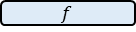
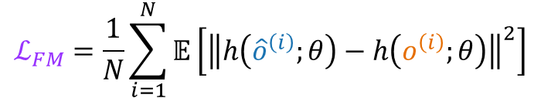
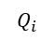
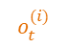
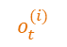
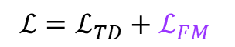
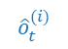
Method (Cont’)
feature matching loss between clean and randomized observation [7]
Effectiveness: more stable against injected randomness
$$ℒ_{FM}=\frac{1}{N}\sum_{i=1}^{N}{𝔼\left[{\left\|h\left({\hat{o}}^{\left(i\right)};θ\right)−h\left(o^{\left(i\right)};θ\right)\right\|}^{2}\right]}$$
feature matching loss
$$Q_{i}$$
$$Q_{i}$$
$$ℒ=ℒ_{TD}+ℒ_{FM}$$
layer
layer
layer
layer
layer
layer
$${\hat{o}}_{t}^{(i)}$$
$$f$$
$$o_{t}^{(i)}$$
$$o_{t}^{(i)}$$
[7] K. Lee, K. Lee, J. Shin, and H. Lee, "Network randomization: A simple technique for generalization in deep reinforcement learning," arXiv preprint arXiv:1910.05396, 2019.
Notes:
(1) To learn more invariant features, the following 'feature matching loss' between hidden features from clean and randomized observations is also considered.
(2) Hidden features are the output of hidden layers in the MLP network of agents.
(3) It makes model more stable against injected randomness.
(4) This loss is combined with the TD loss.

Slide 13
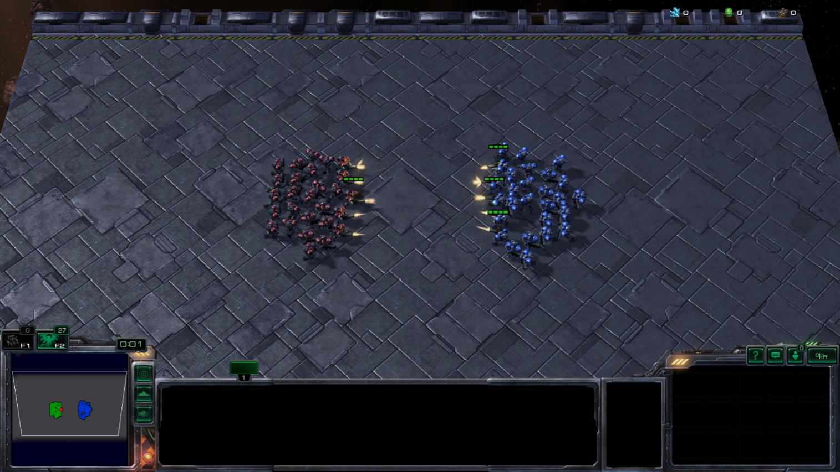
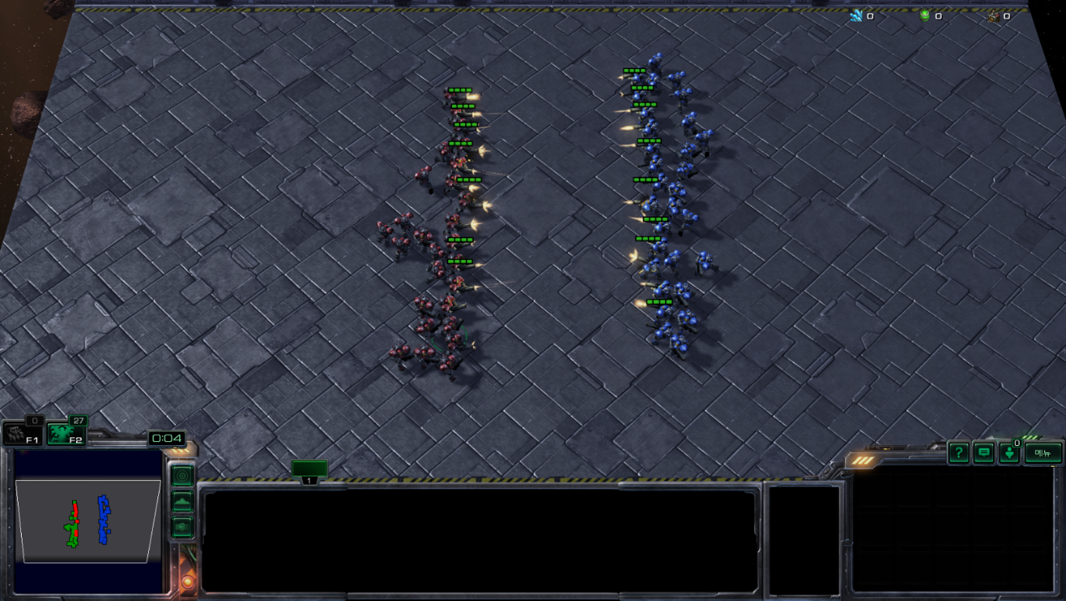
Experimental Setup
27m(easy)
※ simplified variant of 27m_vs_30m
27m_vs_30m(super hard)
agents
agents
27 RL agents
27 built-in AI
27 RL agents
30 built-in AI
knowledge transfer
Name | n_agents | Difficulty
2s_vs_1sc | 2 | Easy
2c_vs_64zg | 2 | Hard
3s_vs_5z | 3 | Hard
.. | .. | ..
MMM2 | 10 | Super Hard
bane_vs_bane | 24 | Hard
27m_vs_30m | 27 | Super Hard
StarCraft Multi-Agent Challenge(SMAC)
target task: 27m_vs_30m most agents in the SMAC
source task: learn general knowledge
List of SMAC scenarios
Notes:
(1) To demonstrate our method, we use StarCraft Multi-Agent Challenge(SMAC) as our environment, which is an excellent benchmark in multi-agent problems.
(2) We designed an experiment that trains on the source scenario, 27 marines, and then transitions to the target scenario, 27 marines vs 30 marines.
(3) Notably, 27 marines are the most agents in the SMAC and the most challenging scenario to learn.
(4) Our experimental setup is designed to help agents learn general knowledge before they move on to the highly complex target scenario.

Slide 14
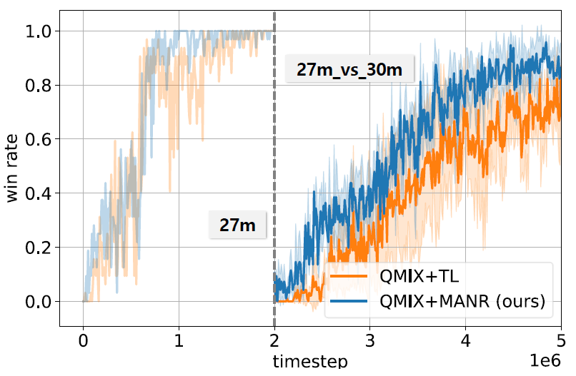
Result: Performance
89.59%
82.30%
Win rate result graph
We validate our method based on QMIX algorithm
QMIX+MANR (ours) : QMIX combined with our proposed method
QMIX+TL (baseline) : the application of vanilla transfer learning to QMIX
Notes:
~~
QMIX is popular and fundamental algorithm in MARL.
QMIX+MANR denotes QMIX combined with our proposed method, and QMIX+TL is the application of vanilla transfer learning to QMIX.
Our method showed a performance improvement of over 7% compared to baseline.
We can see the introduction of MANR has a significant impact on the performance in multi-agent problem.

Slide 15
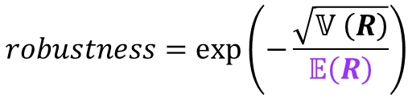
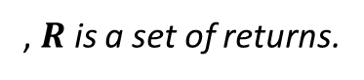
Robustness Definition
Robustness : degree of stability in predictive performance despite variations in input data. [8]
We need a task independent metrics.
We define robustness as the standard deviation normalized by the mean over the returns of multiple episodes.
$$robustness=\exp\left(−\frac{\sqrt{𝕍 \left(R\right)}}{𝔼\left(R\right)}\right)$$
, $R$ is a set of returns.
[8] H. B. Braiek and F. Khomh, "Machine Learning Robustness: A Primer," arXiv preprint arXiv:2404.00897, 2024.
Notes:
Furthermore, we want to show that if our method contributes to the robustness improvement.
Robustness is typically defined as the degree of stability in predictive performance despite variations in input data.
In particular, we needed a task independent metric, so we designed a metric using normalized robustness.
~~

Slide 16
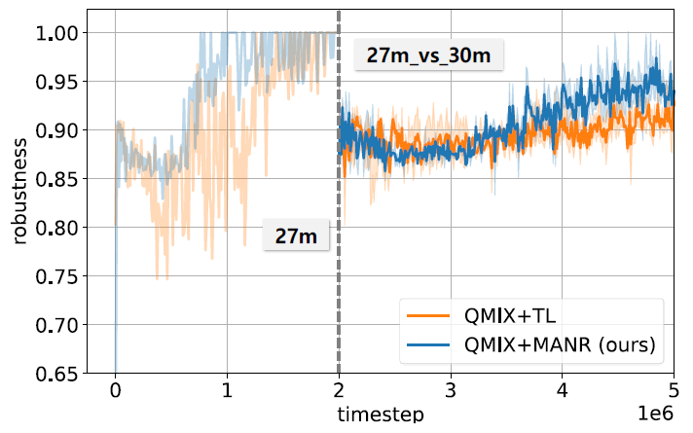
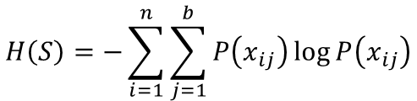
Result: Robustness and Entropy
0.9384
QMIX+MANR (Ours) | QMIX+TL (Baseline)
0.5401 | 0.3620
0.9151
Table of entropy results
$$H\left(S\right)=−\sum_{i=1}^{n}{\sum_{j=1}^{b}{P\left(x_{ij}\right)\log{P\left(x_{ij}\right)}}}$$
Robustness result graph
Entropy formula
We compared robustness for QMIX+MANR and QMIX+TL with the same setup.
Improved robustness and entropy suggest that our method makes the model more general.
Notes:
We show the robustness of our method using previously defined metric.
~~~
Our method performed better than baseline.
Although, we evaluate the diversity of the state space using entropy.
Our method has improved entropy compared to the baseline.
These results suggest that our method helps to make the model more robust by improving its generalization.
n: # of features, b: # of interval discretizing each feature.

Slide 17
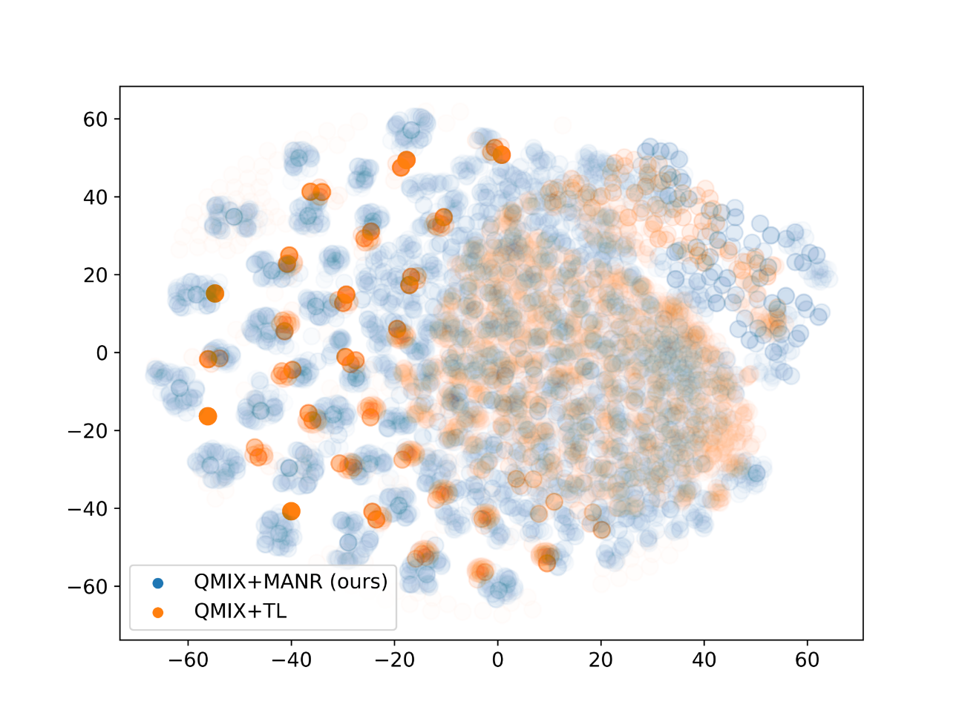
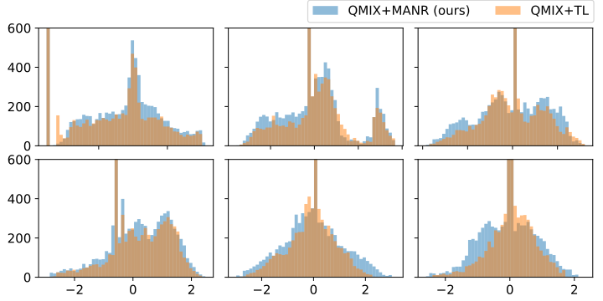
Result: t-SNE and PCA
t-SNE clustering analysis
PCA visualization analysis
We show t-SNE and PCA analysis to verity qualitative results.
Two visualizations show the better generalization ability of our method compared to the baseline.
Notes:
To verify qualitative results, we conducted t-SNE and PCA analysis.
Our method, the blue one, covers a larger area than the orange one.
The expanded visualization demonstrates that our method has a better generalization capability.
--
We collect 10,000 state samples and use t-SNE clustering and PCA projection. First, the t-SNE visualization shows that our method has increased sample diversity. Next, in PCA visualization, our method relaxes and spreads out over a wider range. It means that our method makes the model more general.

Slide 18
Conclusion
We propose MANR method to improve the generalization ability for applying to MARL.
The MANR method injects randomness into the training data by introducing random layers.
Our method aims to - enhance robustness and facilitate knowledge transfer, - be compatible with almost MARL algorithms, - and be easy to implement.
Dohyun Kim, Hoseong Jung, Jungho Bae*
00dh.kim@gmail.com

Slide 19
Conclusion
We propose MANR method to improve the generalization ability for applying to MARL.
The MANR method injects randomness into the training data by introducing random layers.
Our method aims to - enhance robustness and facilitate knowledge transfer, - be compatible with almost MARL algorithms, - and be easy to implement.
Dohyun Kim, Hoseong Jung, Jungho Bae*
00dh.kim@gmail.com

Slide 20
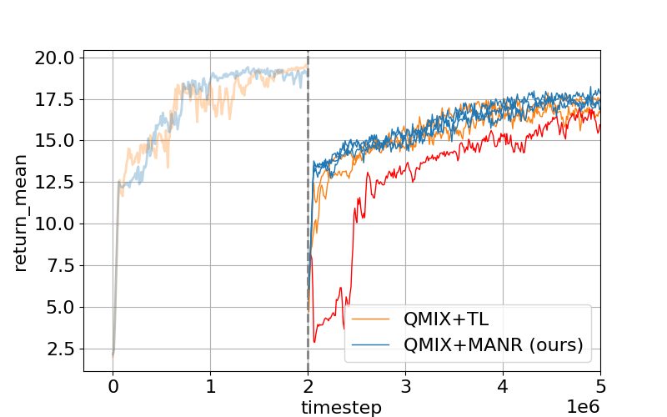
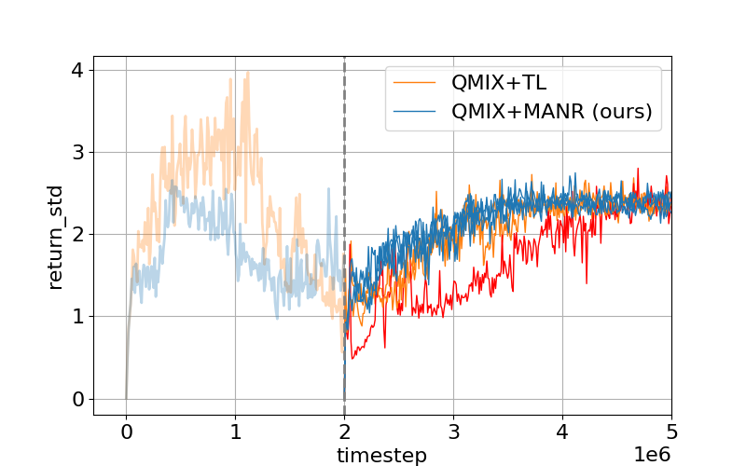
Appendix

Slide 21
Appendix
domain randomization | multi-agent network randomization
randomize elements of environments (e.g., lighting, textures, physical properties) task-dependent method | add random layer to network task-independent method increase robustness

